Slide 1

Risk Analytics in Banking
Power BI dashboards for data-driven lending decisions

Slide 2

Project Overview
Objective
Solution
Develop risk analytics to minimize losses while lending by analyzing customer profiles and repayment likelihood.
Interactive Power BI dashboards that evaluate applicant profiles to approve or reject loan applications based on risk assessment.

Slide 3





Dataset Structure
Multiple interlinked tables connected through primary and foreign keys:
Banking Relationship
Client-Banking
Gender
Investment Advisor
Period

Slide 4



Data Cleaning Process
Income Binning
Created income bands: <100K as Low, <300K as Mid
Processing Fees
New column based on fee structure: High = 0.05

Slide 5
Key Calculated Functions
1
2
3
SUM
SUMX
SWITCH
Adds all numbers in a column. Returns decimal number.
Sum of expression evaluated for each row.
Evaluates expression against values list.
SUM('Clients - Banking'[Bank Deposits])
SUMX('Clients - Banking', [Total Loan] * [Processing Fees])
SWITCH([Fee Structure], "High", 0.05, "Low", 0.02)

Slide 6

Loan Metrics
Total
Bank
Business
Total Loan
Bank Loan
Business Lending
Bank Loan + Business Lending + Credit Cards Balance
Amount to be repaid by client to bank
Loan amount given to small businesses

Slide 7

Deposit Metrics
Bank
Savings
Bank Deposit
Savings Account
Money put in the bank
Interest-bearing deposit account
Foreign
Checking
Foreign Currency
Checking Account
Account in non-Indian currency
Daily transactional needs
Total Deposit = Bank Deposit + Savings Account + Foreign Currency + Checking Accounts

Slide 8



Additional Metrics
Total CC Amount
Total Fees
Engagement Length
Short-term financing source from bank credit cards
Charges for account setup and maintenance
Customer engagement days with digital banking

Slide 9
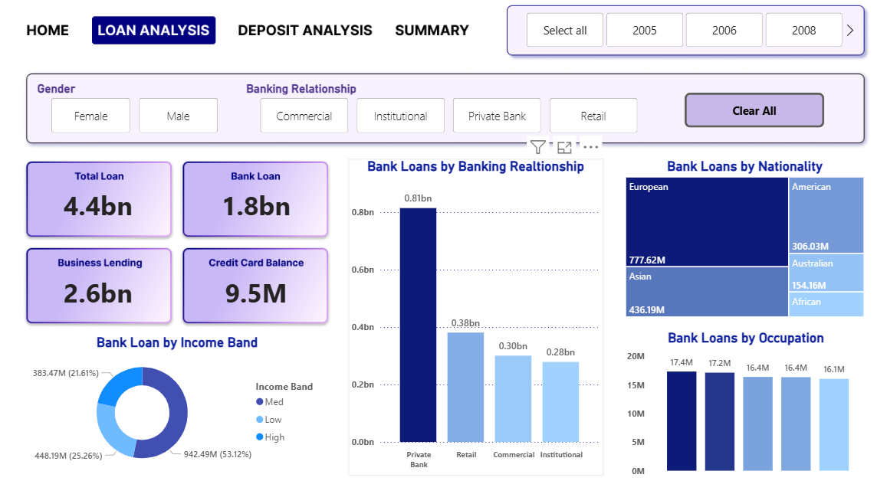

Dashboard Visualizations
Loan Analysis

Slide 10
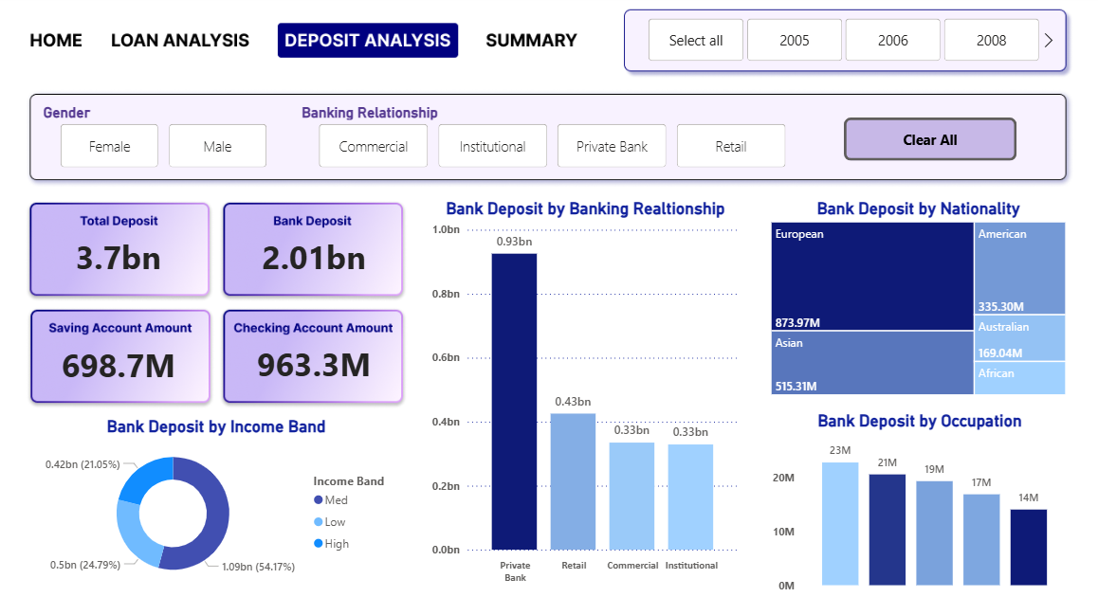

Deposit Analysis

Slide 11

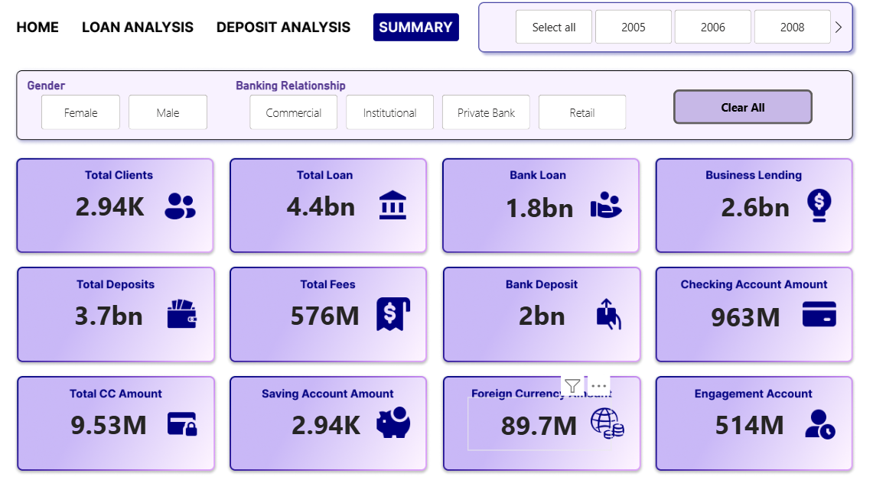
Summary

Slide 12

Impact & Future Applications
Strategic Insights
Competitive Strategy
Identify which banks have most clients (private banks lead) and which nationalities have highest loans
Help banks build strategies to increase client base based on market analysis
Comprehensive Tracking
Monitor total loan amounts and various account types by investors in real-time

